Slide 1
A Project on Credit Card Default Prediction
By:
Amit Kumar Basistha
Pragalbh Awasthi
Bhavesh Pandya
Aditya Garg
Working Under Prof. Rituparna Sen
Group 8

Slide 2
Why This Project?
In 2006, card-issuing banks in Taiwan over-issued cash and credit cards wanting to increase market share. However, these cards ended up being overused and the card holders, failing to make even the minimum payment due over extended periods, accumulated heavy credit-card debt.
From September 2008 to March 2010, credit card limits of millions of people in the United States were increased and the banks became less willing to extend new credit.
More recently, in the fourth quarter of 2022, total credit card debt in US reached a record $930.6 billion, according to the latest credit report from TransUnion.
Such instances of debt crisis suggest the need for a reliable identification scheme for probable defaulters.

Slide 3
What is a Credit Card Default?
A credit card default happens when a customer fails to make even the minimum payment due on their statement balance over an extended period of time.
Typically, when a cardholder is unable to make the minimum payment due for six months in a row, the account defaults and the bank cancels its agreement with the cardholder.
Such defaulted credit cards tend to negatively impact banks by reducing their profit.
It is therefore essential for a robust financial system that banks implement careful risk prediction mechanisms to avoid situations of crisis both for the customers and themselves

Slide 4
How to Predict a Default?
We use several data mining techniques to train classifier models that give the probability of a given customer being defaulter based on certain features (past payment data, education, age etc.).
These models are based on machine learning algorithms and artificial intelligence.

Slide 5
A Digression into Basic Machine Learning

Slide 6
What is Machine Learning ?
Machine learning is an important component of the growing field of data science. Through the use of statistical methods, algorithms are trained to make classifications or predictions, and to uncover key Insights in data mining projects.
These insights subsequently drive decision making within applications and businesses.

Slide 7
Data Processing in Machine Learning
The main steps involved in data processing are:
Data cleaning: This step involves identifying and removing any missing, duplicate, or irrelevant data.
Data transformation: This step involves converting the data into a format that is suitable for modeling. This can involve normalizing the data, converting categorical data Into numerical data, and reducing the dimensionality of the data.
Data preparation: This step involves splitting the data into training and testing datasets. The training dataset Is used to train the ML model, while the testing dataset is used to evaluate the performance of the model.

Slide 8
Advantages of Data Processing
Improved model performance: Data processing helps improve the performance of the ML model by cleaning and transforming the data into a format that is suitable for modeling.
Better representation of the data: Data processing allows the data to be transformed into a format that better represents the underlying relationships and patterns In the data, making it easier for the ML model to learn from the data.
Increased accuracy: Data processing helps ensure that the data Is accurate, consistent, and free of errors, which can help Improve the accuracy of the ML model.

Slide 9
How a Machine Learns?
The learning system of a machine learning algorithm can be divided into three main parts:-
A Decision Process: In general, machine learning algorithms are used to make a prediction or classification. Based on some input data, which can be labeled or unlabeled, your algorithm will produce an estimate about a pattern in the data.
A Cost Function: An cost function evaluates the prediction of the model. If there are known examples. It can make a comparison to assess the accuracy of the model.
A Model Optimization Process : If the model can fit better to the data points In the training set, then weights are adjusted to reduce the discrepancy between the known example and the model estimate. The algorithm will repeat this “evaluate and optimize” process, updating weights autonomously until a threshold of accuracy has been met. Overfitting needs to be taken care of in this process.

Slide 10
Description of Data

Slide 11
Description of Data
The data was collected by I-Cheng Yeh of Chung Hua University from an important Taiwanese Bank in October, 2005 and the targets were the credit card holders of the bank.
It consisted of payment data of 30,000 credit card holders of an important bank in Taiwan out of which 6636 (22.12%) were cardholders with default payments. For each cardholder, a binary variable Y for default payment (Yes =1, No=0) and 23 feature variables (X1 to X23) and were recorded.
Note that there is a strong class imbalance in the data. This will be dealt with soon using an oversampling technique.

Slide 12
Feature Variables
We use the following variables to characterise a data point:
X1: Amount of the given credit (NT dollar): it includes both the individual consumer credit and his/her family (supplementary) credit.
X2: Gender (1 = male; 2 = female).
X3: Education (1 = graduate school; 2 = university; 3 = high school; 4 = others).
X4: Marital status (1 = married; 2 = single; 3 = others).
X5: Age (year).
X6–X11: History of past payment. We tracked the past monthly payment records (from April to September, 2005) as follows: X6 = the repayment status In September, 2005; X7 = the repayment status in August, 2005;...; X11 = the repayment status in April, 2005. The measurement scale for the repayment status is: 1 = pay duly; 1 = payment delay for one month; 2 = payment delay for two months; ...; 8 = payment delay for eight months; 9 = payment delay for nine months and above.

Slide 13
Feature Variables
X12–X17: Amount of bill statement (NT dollar). X12 = amount of bill statement in September, 2005; X13 = amount of bill statement in August, 2005; X17 = amount of bill statement in April, 2005.
X18–X23: Amount of previous payment (NT dollar). X18 = amount paid In September, 2005; X19 = amount paid in August, 2005;...;X23 = amount paid in April, 2005
The data was randomly divided into two groups in the ratio 80:20 for training and testing respectively.

Slide 14
The Problem Of Class Imbalance
In our dataset, 77.88% of cardholders are risk-free giving rise to a high class imbalance.
Since we aim to achieve the best results in predicting default risk of a given cardholder, i.e. the probability of the cardholder being in the minority class, such huge bias towards risk-free card holders can considerably degrade the performance of a given binary classifier model.
Furthermore, in situations of high class Imbalance, the accuracy of the model no longer remains a reliable measure of its performance.
SMOTE is an oversampling technique used to overcome such problems in binary classifier models.

Slide 15
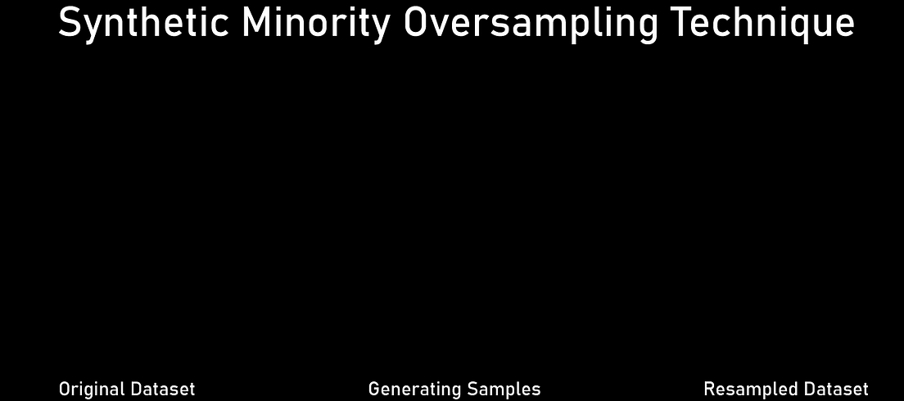
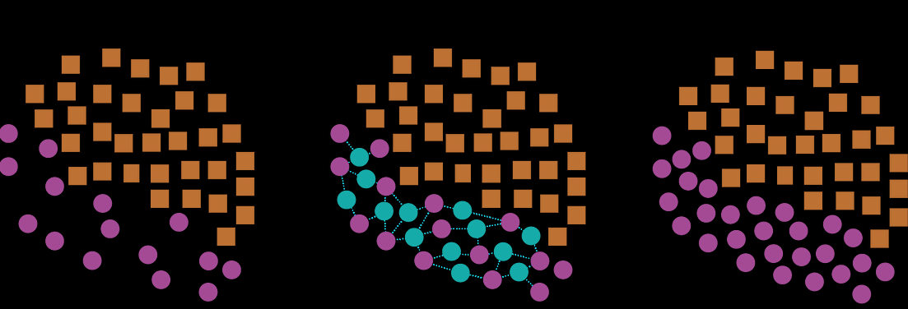
SMOTE

Slide 16
SMOTE
Set M to be the set of data points in minority class. Suppose a total of N synthetic data points (I.e. the oversampling observations) are required per data point in M to reduce the class imbalance to the desired extent.
For each x in M, K of its nearest neighbours in M are identified by using some distance metric defined on the feature space (by default, K = 5).
N of these K neighbours of x are randomly selected. Call them x₁, x₂, …, x_{N}.
For each x_{i}, a random number r between 0 and 1 Is generated. Then y_{i} := x + r*(x_{i} – x) is added to M, and these steps are repeated for each x in M. In the end, N times the number of points originally In M are added to M as synthetic data points.

Slide 17
SMOTE
The basic intuition is that we are moving points in M towards each other to generate more points inside M.
As opposed to other under sampling techniques in which a subset of the majority class is chosen or points already inside M are added to M to avoid class imbalance, in SMOTE, no valuable Information from the data is lost and no duplicate points are generated.

Slide 18
Assessing Performance of a Prediction Model

Slide 19
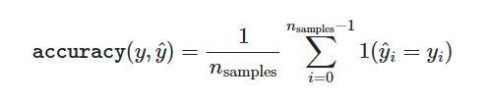
Accuracy
One of the most basic measures of performance of a prediction model is its accuracy which is the ratio of the number of correct predictions by the model to the total number of predictions. Intuitively, it tells how often a model makes a correct prediction. So generally, the higher the accuracy, the better the model.
It Is easy to compute and hence widely used. However, as we have seen, it is not always the best measure in certain situations.

Slide 20
Lift Curve/Cumulative Gains Chart
Cumulative Gains Chart, often referred to as Lift Curve/Chart, plots the number/proportion of prediction class in the chosen sample according to the model vs. the number/proportion of sample size chosen.
In our case, the lift chart shows how much more likely the model is to correctly identify defaulters compared to if it did randomly.
For a better understanding consider the following example:

Slide 21
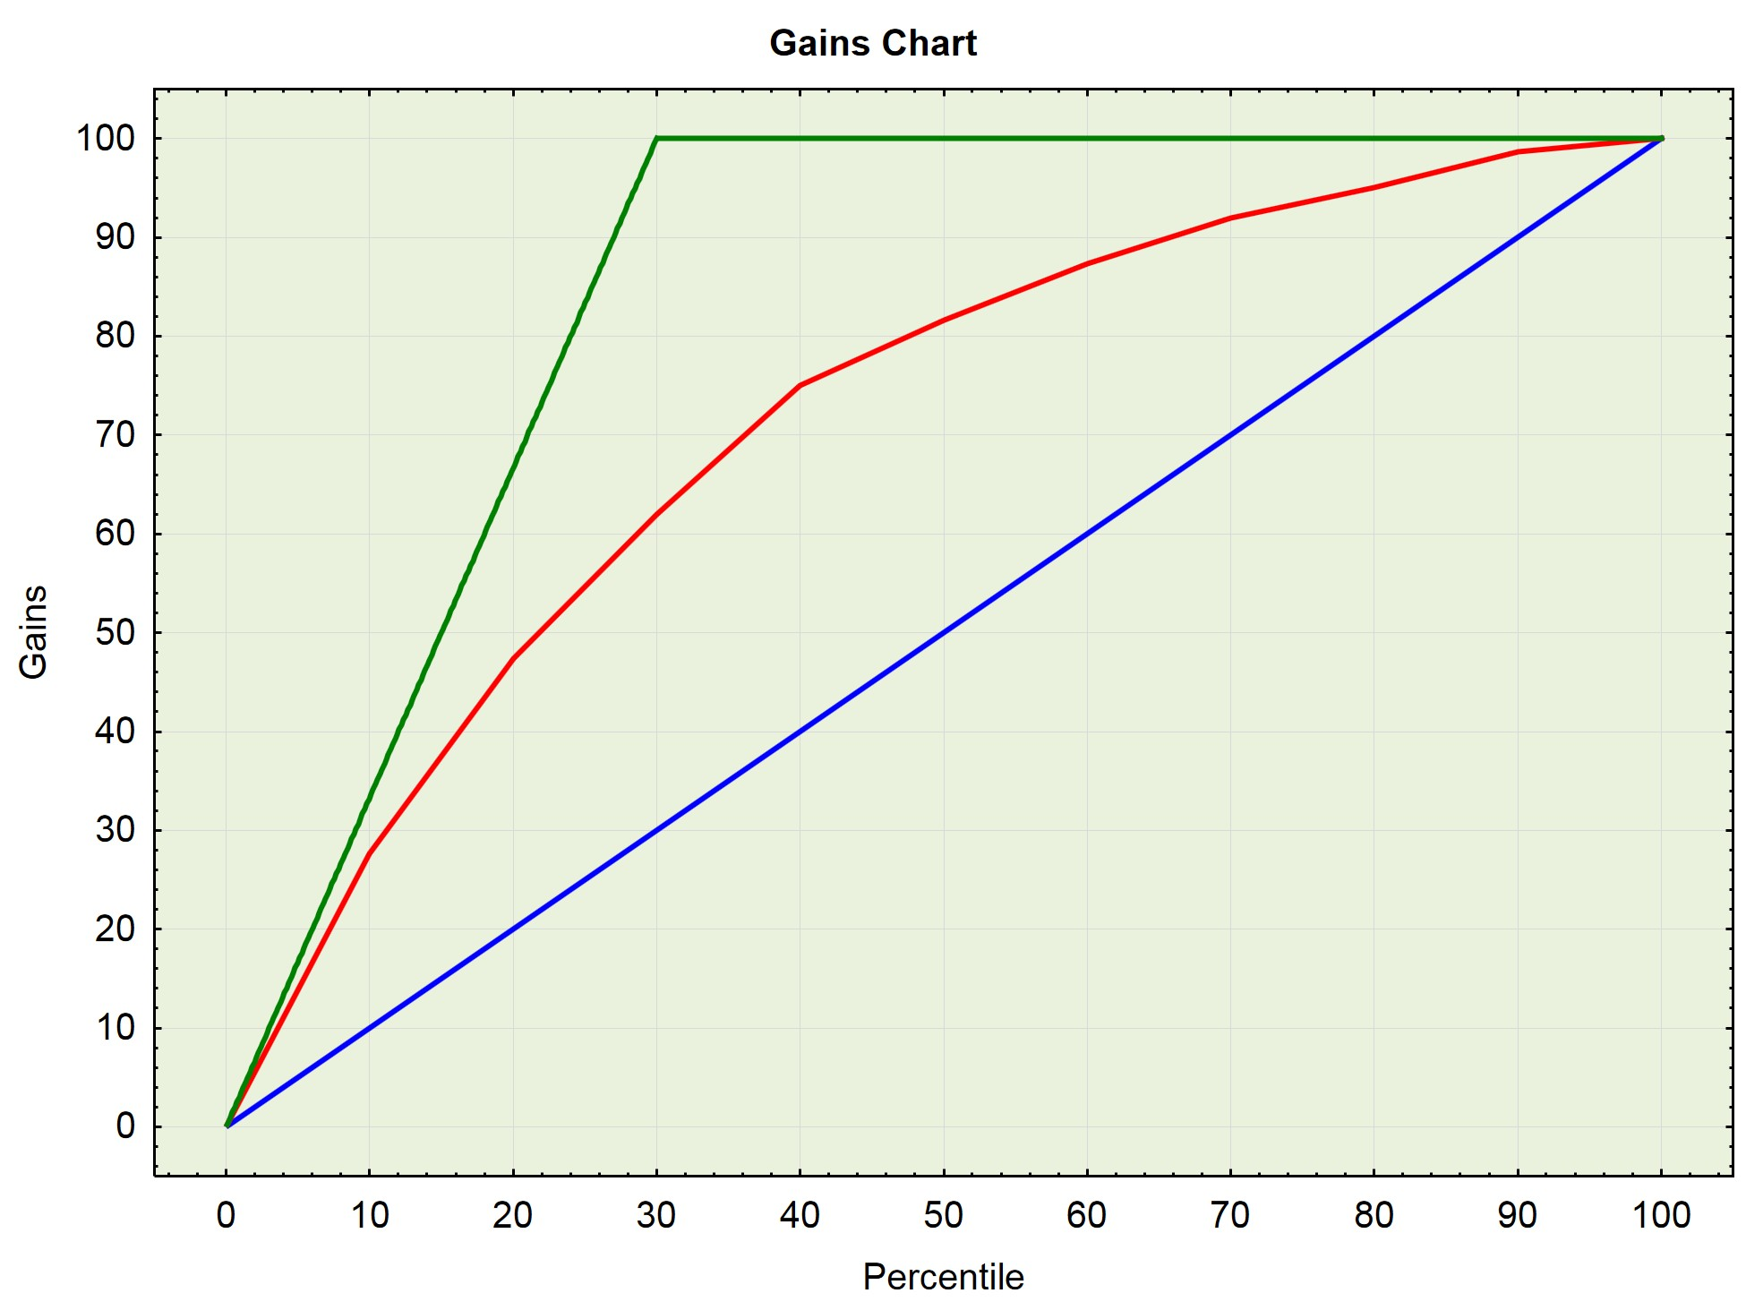
Lift Curve/Cumulative Gains Chart
Suppose that we are building a model to predict who is likely to respond to a direct mail solicitation. Suppose we write out 10,000 emails to a chosen set of people. Out of the recorded responses, 30% responded positively.
We as usual train the machine using some classifier model. The classifier scores each one either as “predicted to response” or as “not predicted to response”.
The percentiles on the horizontal axis is sorted in the decreasing of predicted probabilities of data points based on the model.
An Illustrative Example of Gains Chart

Slide 22
Lift Curve/Cumulative Gains Chart
Now, for any randomly chosen 10% of the 10000 people, we would expect approximately 10% of the positive responses to be in this sample. This is represented by the blue line the chart (the y=x line or the baseline).
Now, given the model we choose our sample as predicted by the model. Now if the model is any good the first 10% of the predicted sample should have at least more than 10% of positive responses. The curve of the model is represented by the red curve.
Now, suppose if we were able to build an ideal model which was capable of predicting exactly the respondents then the 30% predicted sample by such an ideal model will have all the respondents. This is represented by the green curve. This Is called the best fit curve.
An Illustrative Example of Gains Chart

Slide 23
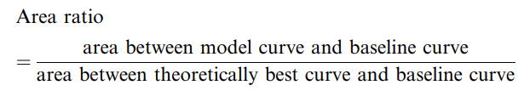
Area Ratio And Its Interpretation
One of the ways to interpret the Cumulative Gains chart is to consider the area ratio. The area ratio for a given model is defined as the ratio of area between the model curve and the baseline to the area between the area between the best fit curve and the baseline.
For a reasonably performing model, It is usually expected to be between 0 and 1. The closer the area ratio is to 1, the closer the model Is to the ideal model and, the better we expect the model to be.

Slide 24
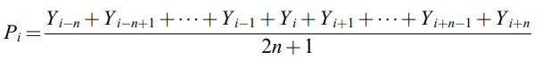
Sorting Smoothing Method (SSM)
To estimate the real probability of default, we use the novel Sorting Smoothing Method.
Firstly, order the validation data in the increasing order of predictive probability.
Secondly, use the SSM to estimate the real probability of default as follows :
where P_{i} = estimated real probability of default In the i^{th} order of validation data; Y_{i} = binary variable with real default risk in the i^{th} order of validation data; Y_{i} = 1 stands for ‘‘happened”; Y_{i} = 0 stands for ‘‘not happened”; n = numbers of data points for smoothing.

Slide 25
Sorting Smoothing Method (SSM)
Treating these P_{i} ’s as the real probability of default we drew a scatterplot with the x-axis representing the predictive default probability and the x-axis representing the real probability of default estimated using SSM.
Then we fitted a linear regression model on the data. If the coefficient of determination(R² ) Is close to 1,the intercept (β₀) close to 0 and the slope (β₁) close to 1 then we can conclude that the model represents the actual probability.

Slide 26
Models & Their Performance

Slide 27
Models Used
Linear Discriminant Analysis
Support Vector Machine
Artificial Neural Networks(Multi Layer Perceptron)
Decision Tree
Random Forest
Naïve Bayes
K-Nearest Neighbours
Logistic Regression

Slide 28

Notations

Slide 29

Linear Discriminant Analysis

Slide 30

Linear Discriminant Analysis

Slide 31
Applying to the Dataset
 | Without SMOTE | With SMOTE
Train Accuracy | 0.8107 | 0.6715
Test Accuracy | 0.8105 | 0.6880
Train Area Ratio | 0.4298 | 0.4513
Test Area Ratio | 0.4612 | 0.4721

Slide 32
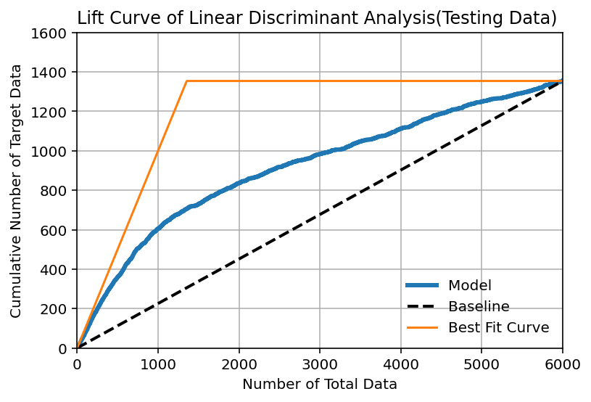
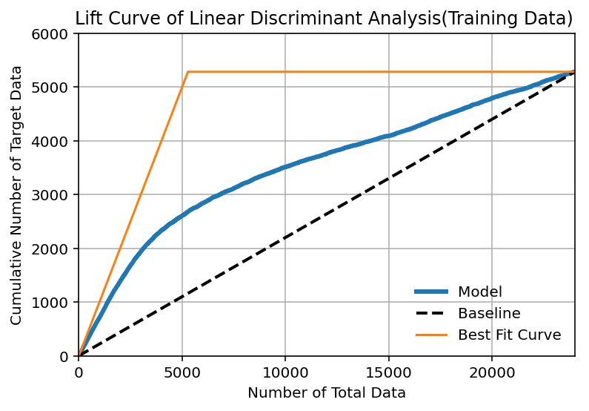
Plots-Lift Curve without SMOTE
Points
Points

Slide 33
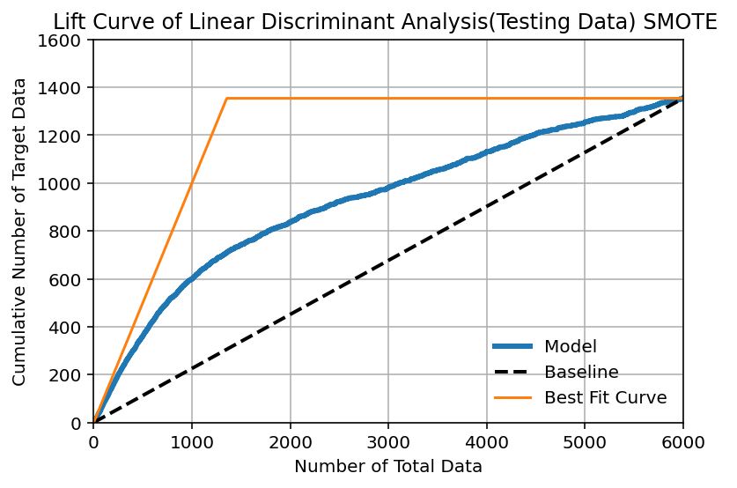
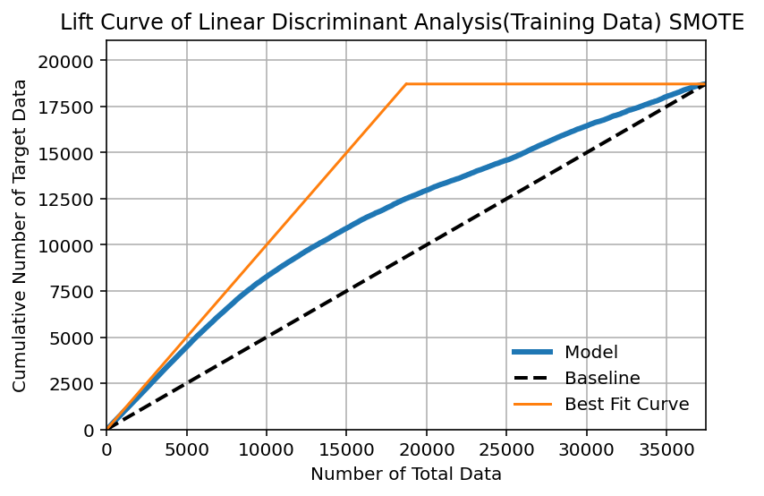
Plots-Lift Curve with SMOTE
Points
Points

Slide 34
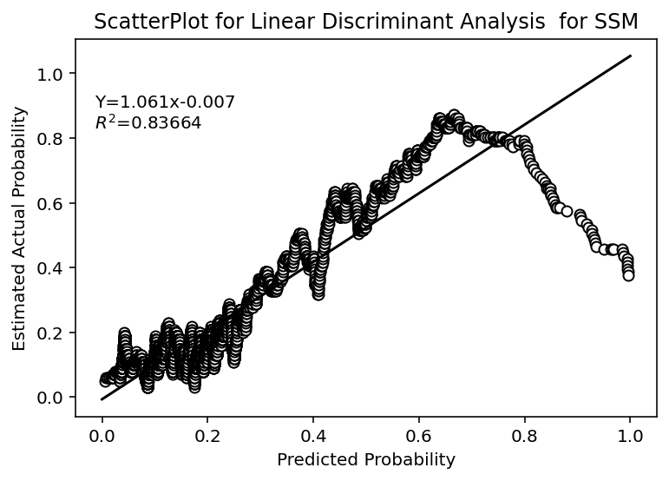
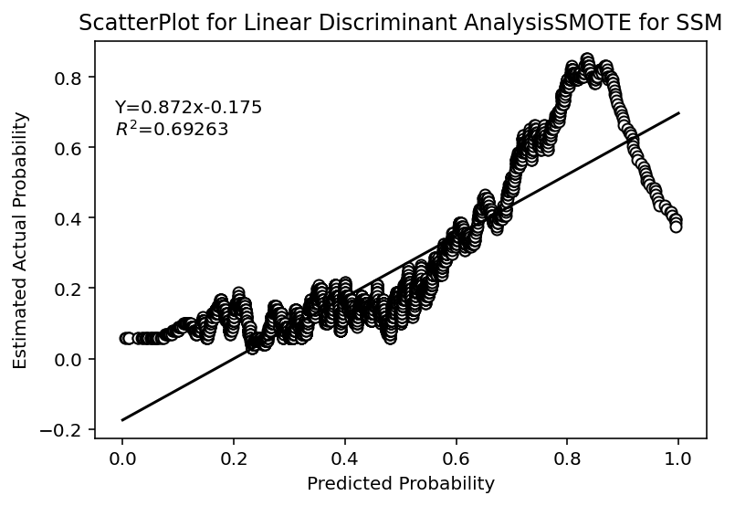
SSM:Graph and Linear Regression

Slide 35

Support Vector Machine

Slide 36

Support Vector Machine

Slide 37
Applying to the Dataset
 | Without SMOTE | With SMOTE
Train Accuracy | 0.8258 | 0.7243
Test Accuracy | 0.8205 | 0.7811
Train Area Ratio | 0.5712 | 0.6201
Test Area Ratio | 0.4544 | 0.5384

Slide 38
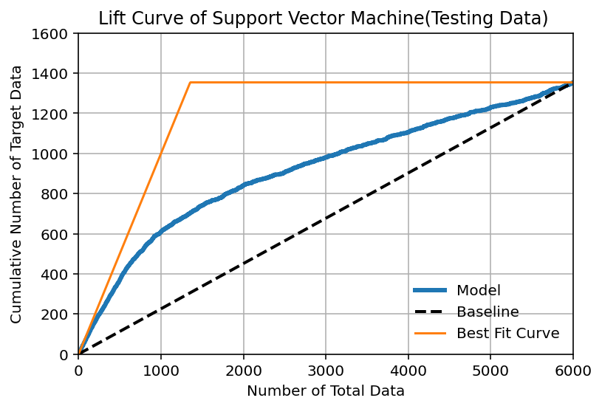
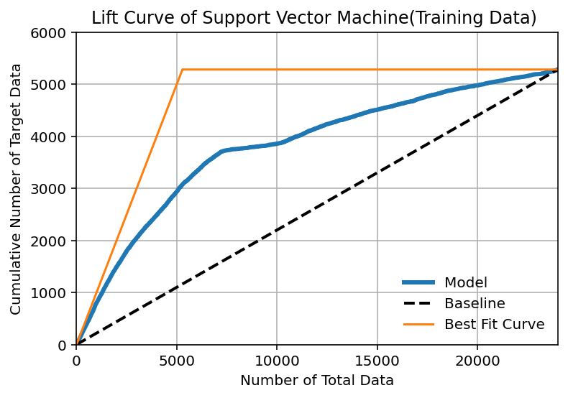
Plots-Lift Curve without SMOTE
Points
Points

Slide 39
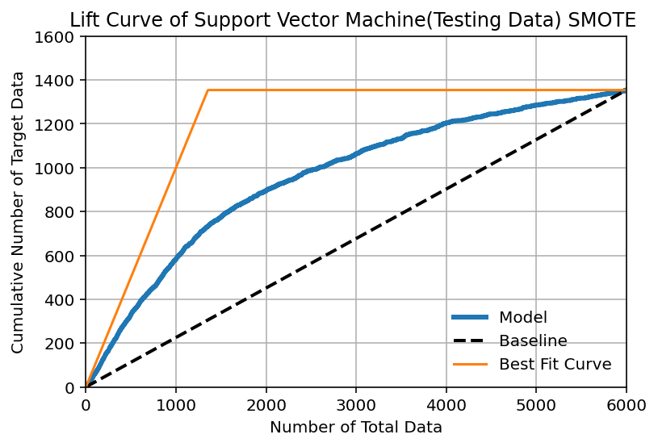
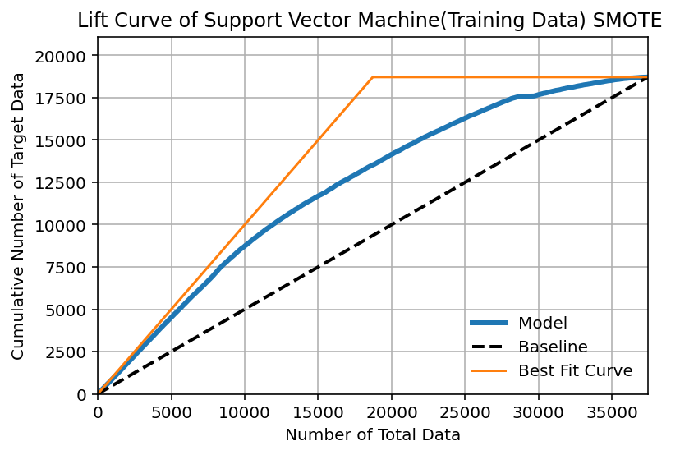
Plots-Lift Curve with SMOTE
Points
Points

Slide 40
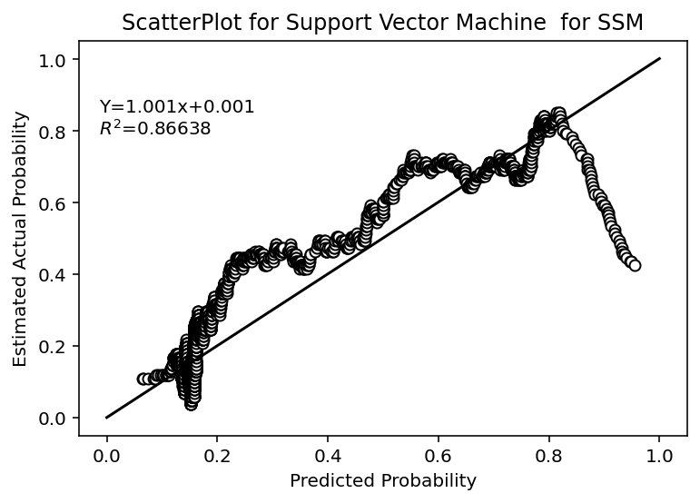
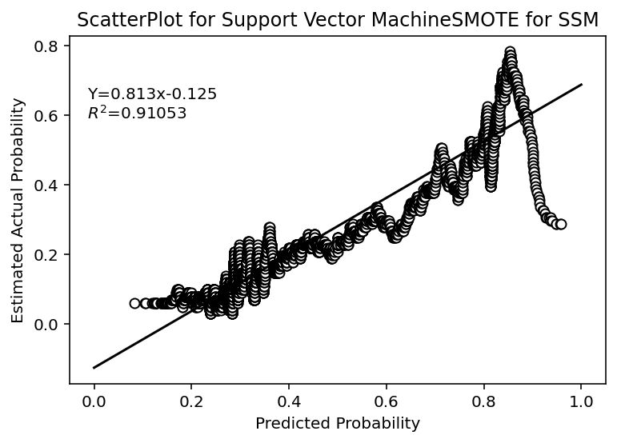
SSM: Graph and Linear Regression

Slide 41

Multi Layer Perceptron(MLP)

Slide 42
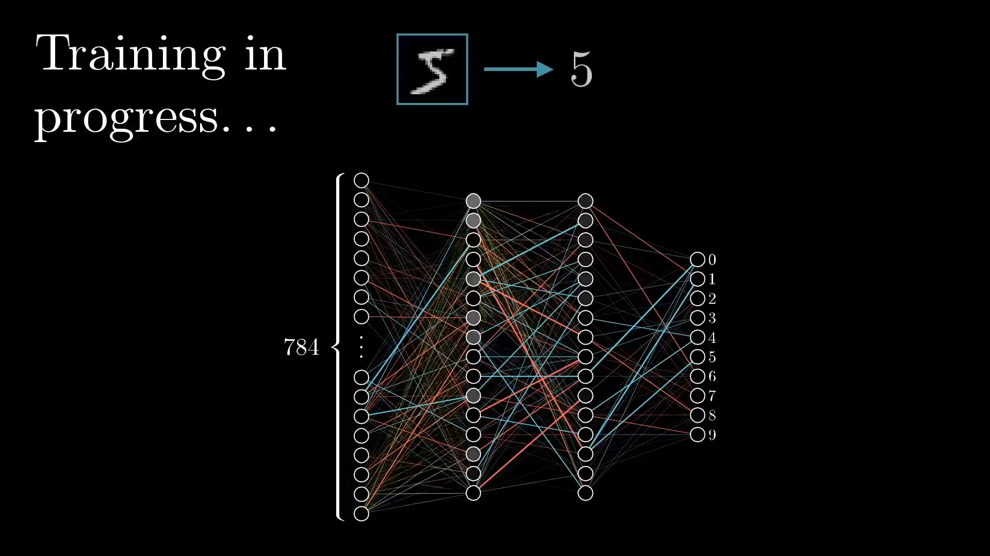
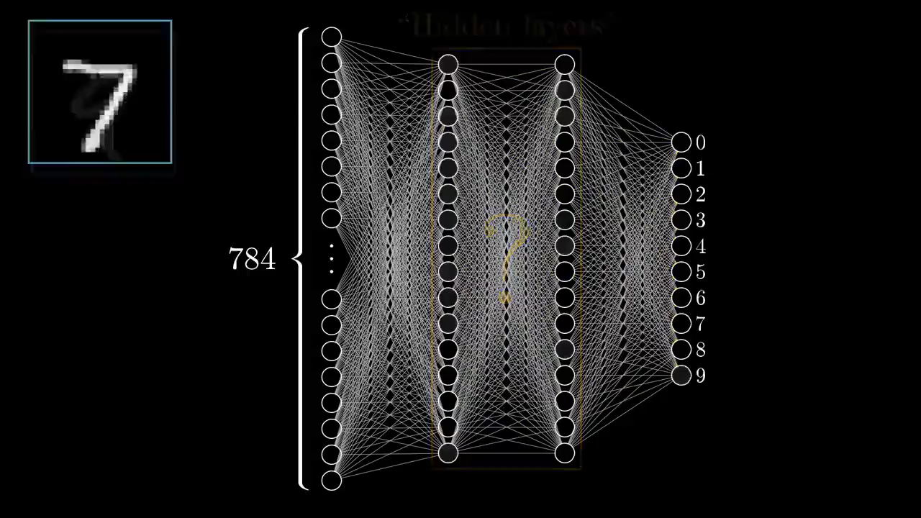
Multi Layer Perceptron(MLP)
Training Process
Decision Making

Slide 43
Applying to the Dataset
 | Without SMOTE | With SMOTE
Train Accuracy | 0.8062 | 0.6732
Test Accuracy | 0.8068 | 0.6870
Train Area Ratio | 0.4398 | 0.4639
Test Area Ratio | 0.4661 | 0.4808

Slide 44
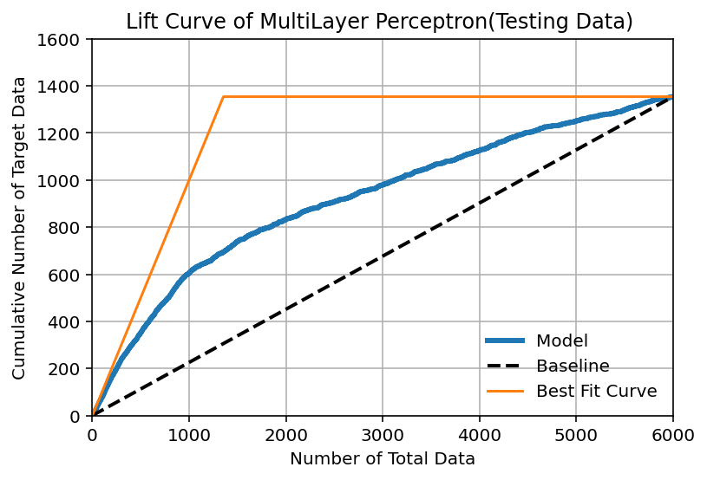
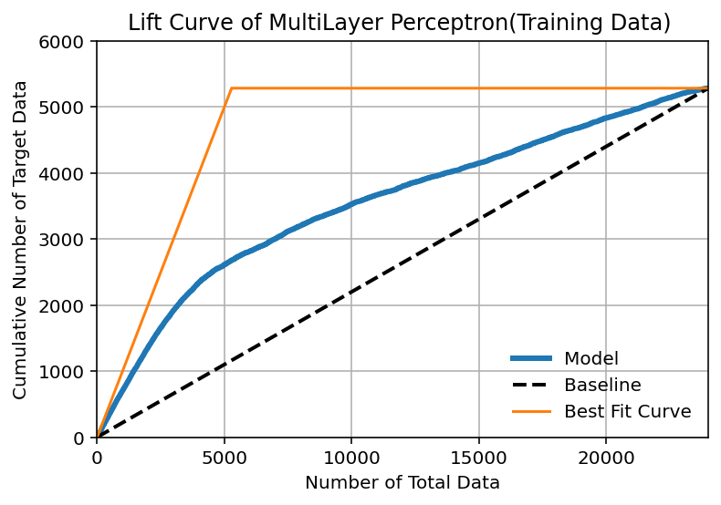
Plots-Lift Curve without SMOTE
Points
Points

Slide 45
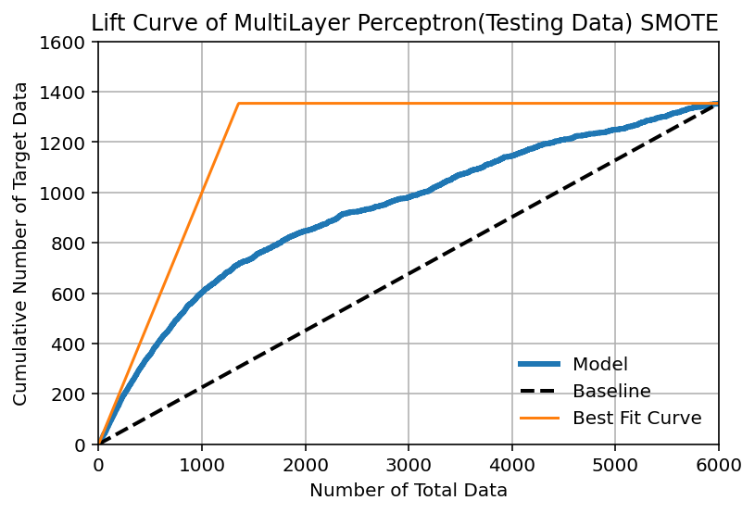
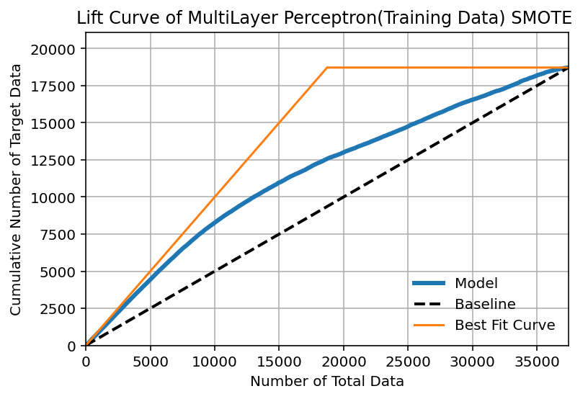
Plots-Lift Curve with SMOTE
Points
Points

Slide 46
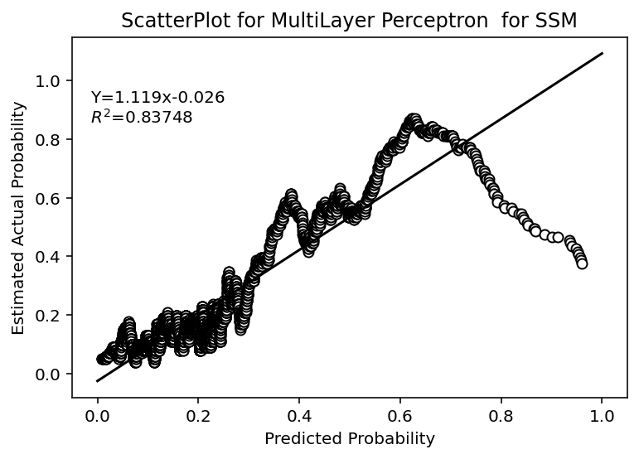
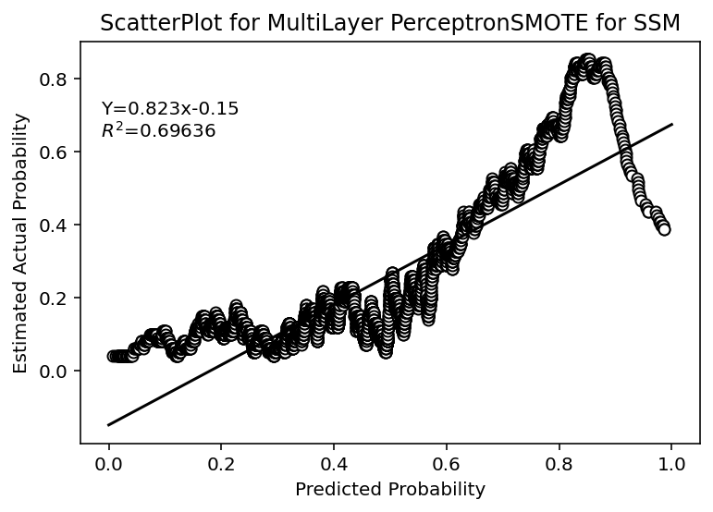
SSM: Graph and Linear Regression

Slide 47
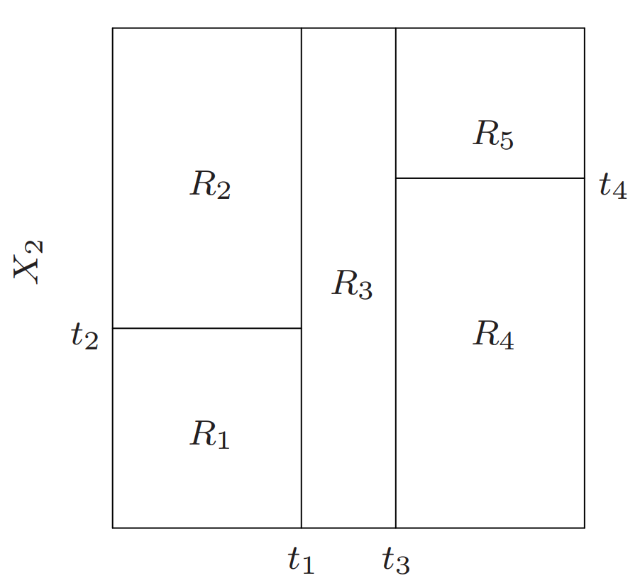
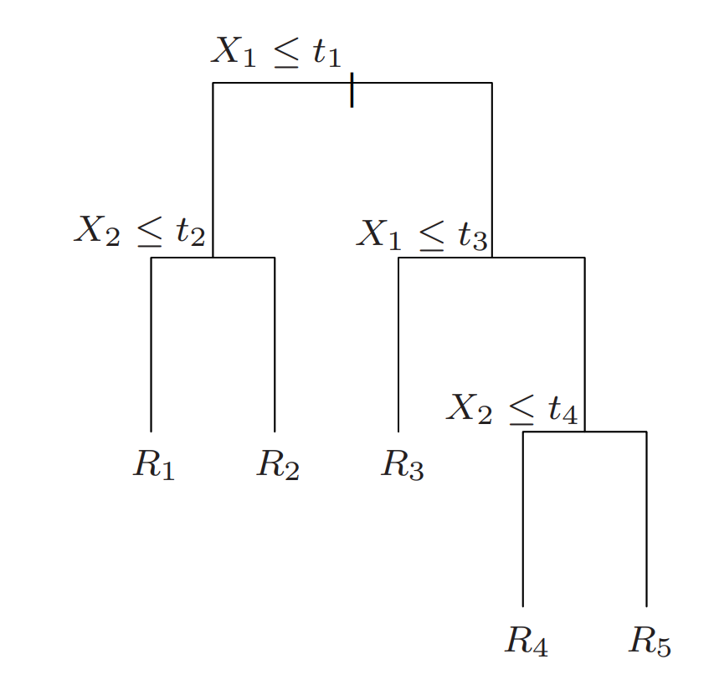
Classification Tree

Slide 48

Classification Tree

Slide 49
Applying to the Dataset
 | Without SMOTE | With SMOTE
Train Accuracy | 0.8216 | 0.7576
Test Accuracy | 0.8213 | 0.7365
Train Area Ratio | 0.5173 | 0.6615
Test Area Ratio | 0.5122 | 0.4977

Slide 50
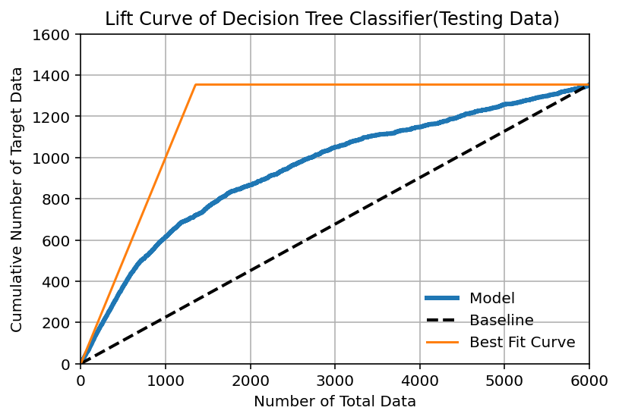
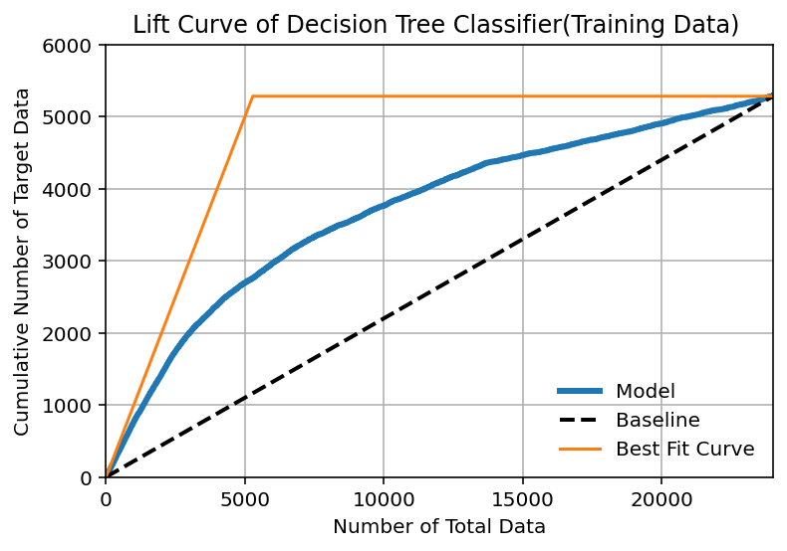
Plots-Lift Curve without SMOTE
Points
Points

Slide 51

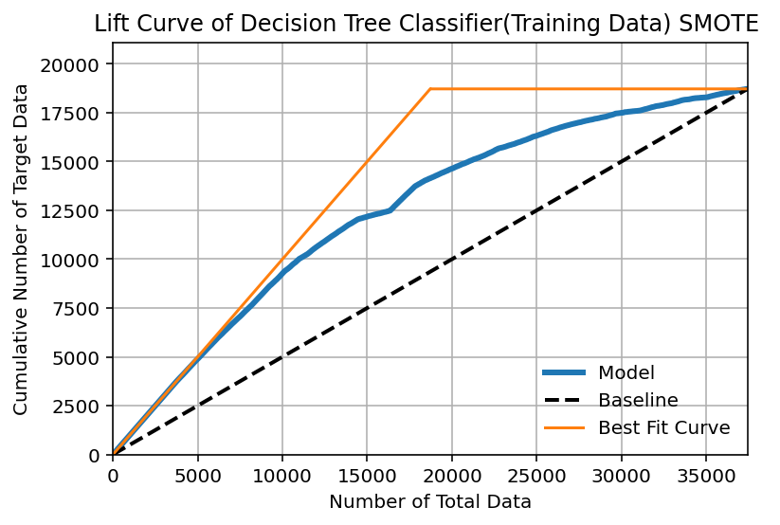
Plots-Lift Curve with SMOTE
Points
Points

Slide 52
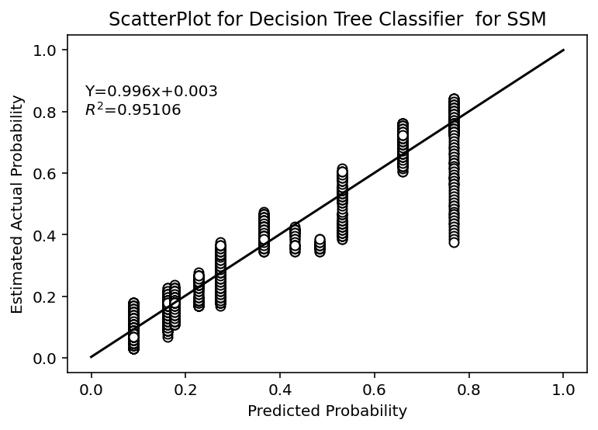
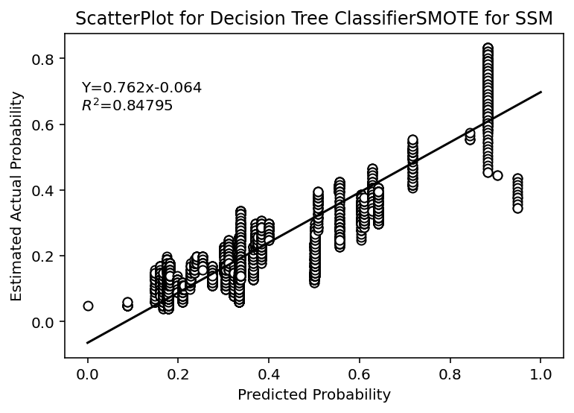
SSM: Graph and Linear Regression

Slide 53

Random Forest

Slide 54

Random Forest

Slide 55
Applying to the Dataset
 | Without SMOTE | With SMOTE
Train Accuracy | 0.8207 | 0.7602
Test Accuracy | 0.8203 | 0.7791
Train Area Ratio | 0.5642 | 0.6719
Test Area Ratio | 0.5669 | 0.5659

Slide 56
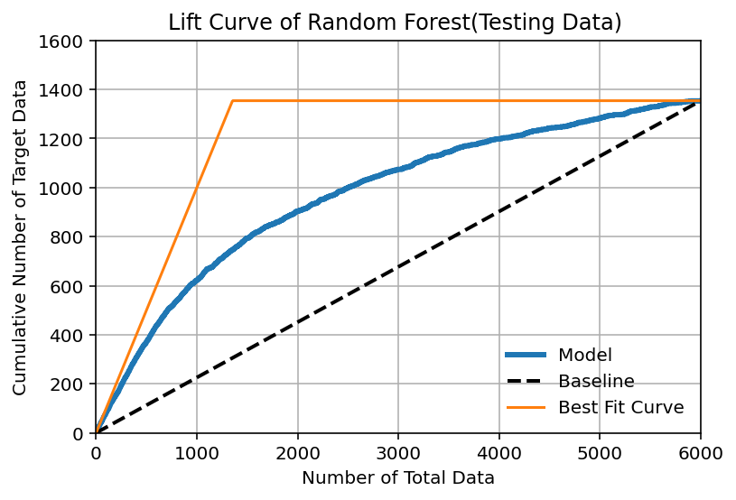
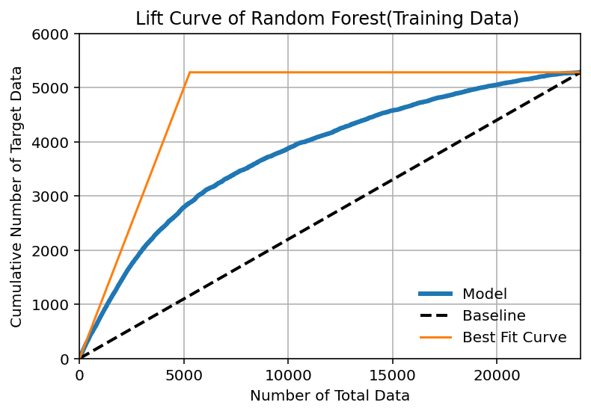
Plots-Lift Curve without SMOTE
Points
Points

Slide 57

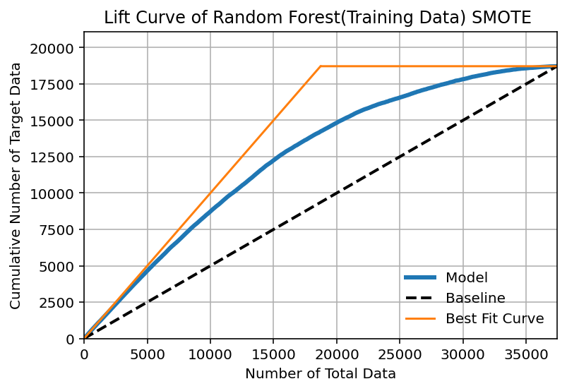
Plots-Lift Curve with SMOTE
Points
Points

Slide 58
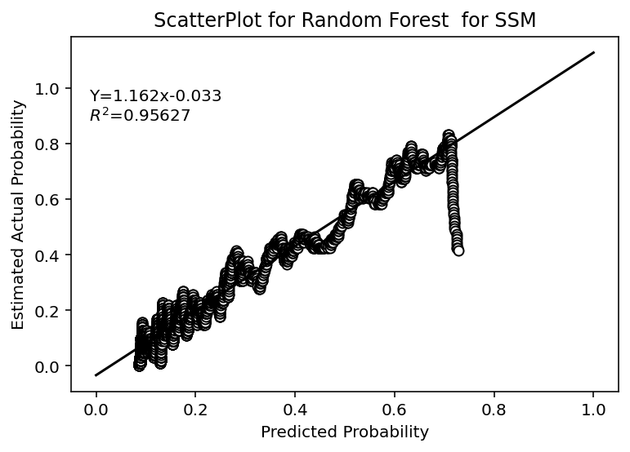
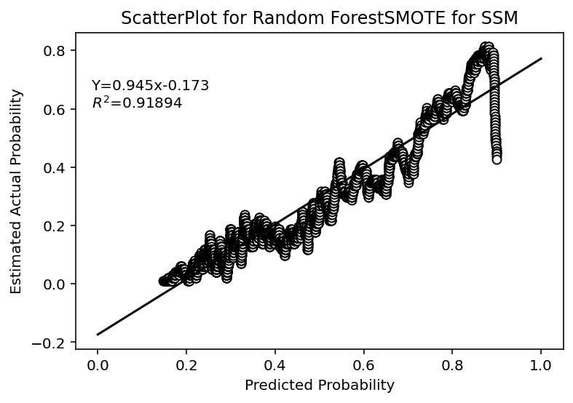
SSM: Graph and Linear Regression

Slide 59

Naïve Bayes

Slide 60

Naïve Bayes

Slide 61
Applying to the Dataset
 | Without SMOTE | With SMOTE
Train Accuracy | 0.7974 | 0.6945
Test Accuracy | 0.7955 | 0.7440
Train Area Ratio | 0.4821 | 0.4735
Test Area Ratio | 0.4897 | 0.4808

Slide 62

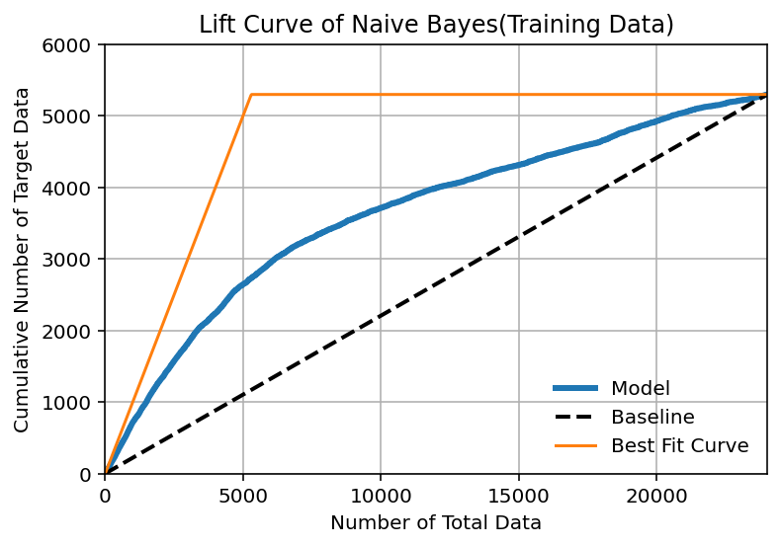
Plots-Lift Curve without SMOTE
Points
Points

Slide 63
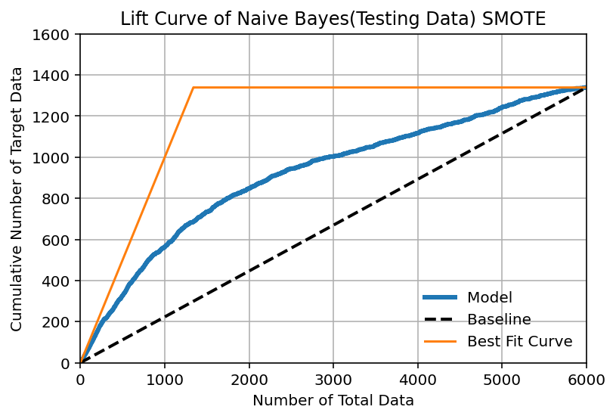
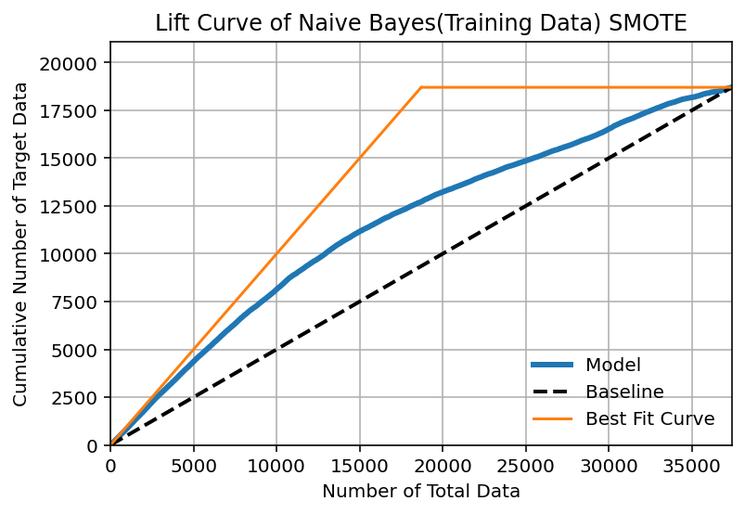
Plots-Lift Curve with SMOTE
Points
Points

Slide 64
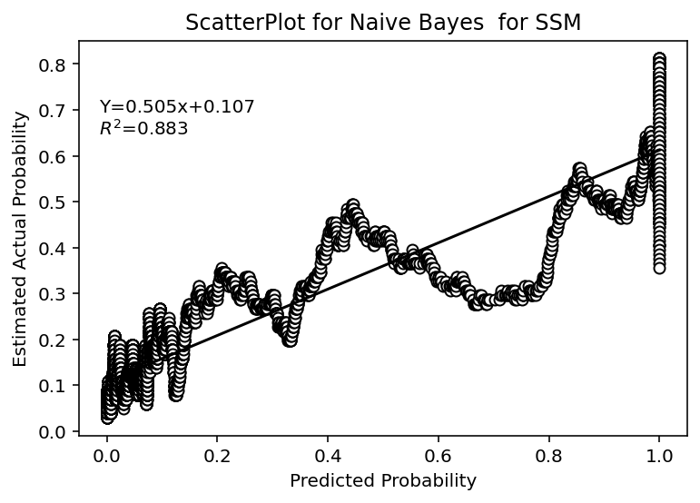
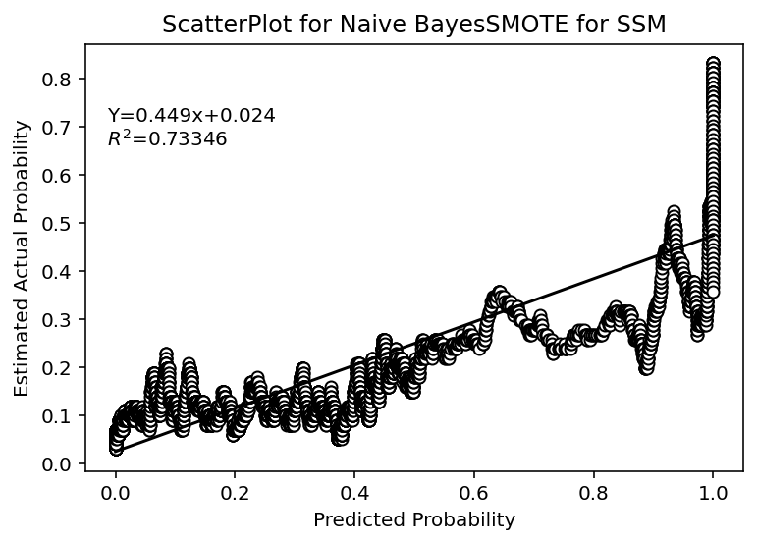
SSM: Graph and Linear Regression

Slide 65

K-Nearest Neighbours

Slide 66
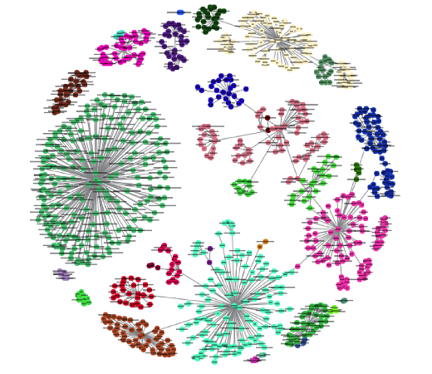
K-Nearest Neighbours

Slide 67
Applying to the Dataset
 | Without SMOTE | With SMOTE
Train Accuracy | 0.8200 | 0.7759
Test Accuracy | 0.8068 | 0.6925
Train Area Ratio | 0.6235 | 0.7286
Test Area Ratio | 0.5011 | 0.4765

Slide 68

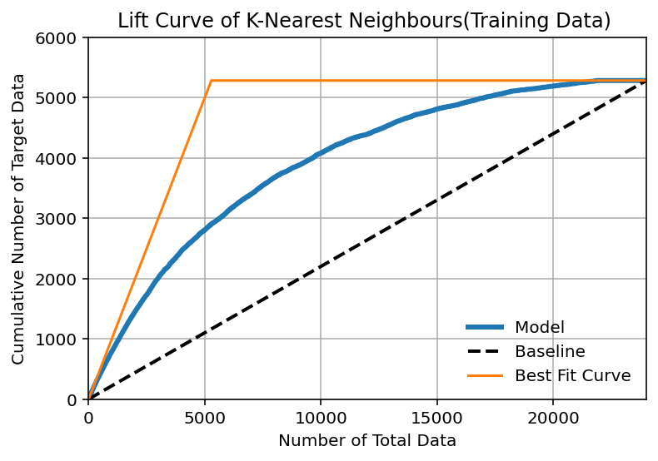
Plots-Lift Curve without SMOTE
Points
Points

Slide 69

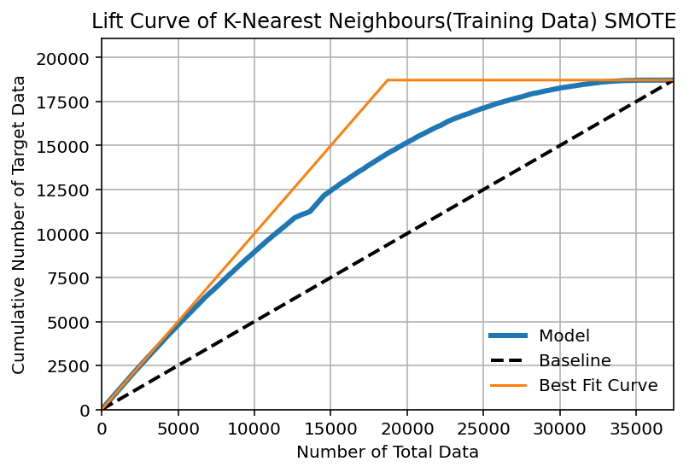
Plots-Lift Curve with SMOTE
Points
Points

Slide 70
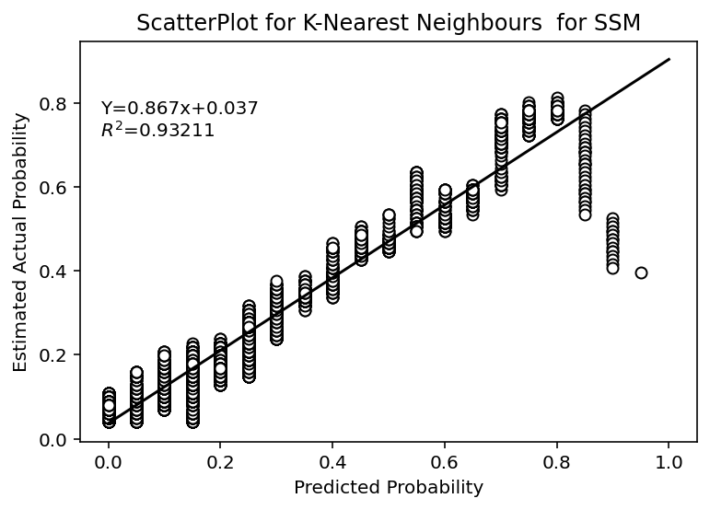
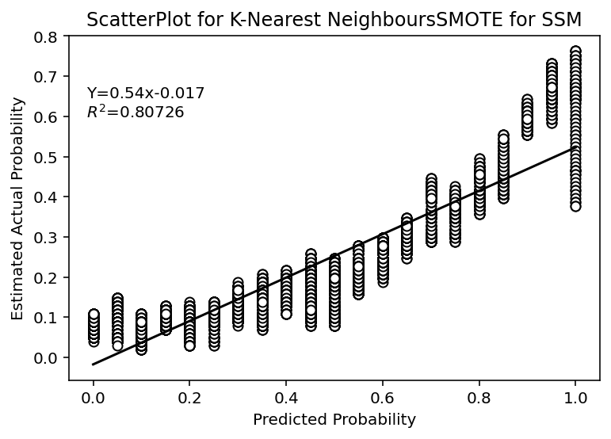
SSM: Graph and Linear Regression

Slide 71

Logistic Regression

Slide 72

Logistic Regression

Slide 73
Applying to the Dataset
 | Without SMOTE | With SMOTE
Train Accuracy | 0.8100 | 0.6706
Test Accuracy | 0.8103 | 0.6803
Train Area Ratio | 0.4418 | 0.4569
Test Area Ratio | 0.4720 | 0.4776

Slide 74

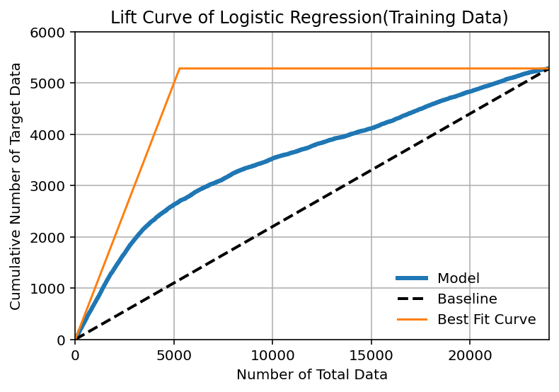
Plots-Lift Curve without SMOTE
Points
Points

Slide 75

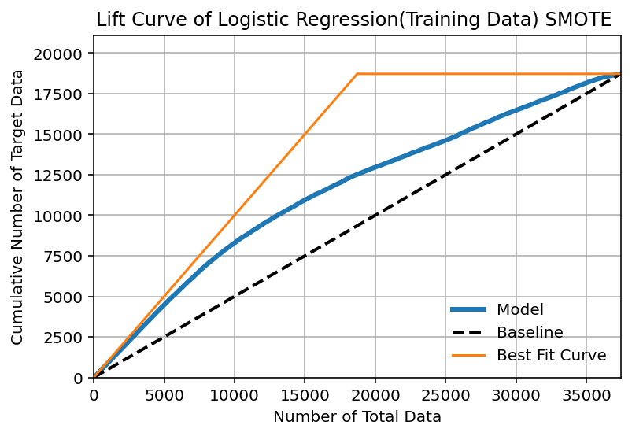
Plots-Lift Curve with SMOTE
Points
Points

Slide 76


SSM: Graph and Linear Regression

Slide 77
Analysis of SSM

Slide 78
Analysis of SSM
The original authors used the value n=50 in Sorting Smoothing Method without giving any justification . So we ran a for loop in python while varying the value of n from 5 to 200 with an increment of 5 and noted down the value of R².The results obtained are presented in the following slides.

Slide 79


Linear Discriminant Analysis

Slide 80


Support Vector Machine

Slide 81


Multi Layer Perceptron

Slide 82


Classification Tree

Slide 83


Random Forest

Slide 84


Naïve Bayes Classifier
(SMOTE)

Slide 85


k-Nearest Neighbours

Slide 86


Naïve Bayes Classifier

Slide 87
Concluding Remarks

Slide 88
Performance Report(Without SMOTE)
Models | Accuracy |  | Area Ratio
 | Training | Testing | Training | Testing
Logistic Regression | 0.8100 | 0.8103 | 0.4418 | 0.4720
k-Nearest Neighbours | 0.8200 | 0.8068 | 0.6235 | 0.5011
Linear Discriminant Analysis | 0.8107 | 0.8105 | 0.4298 | 0.4612
Classification Tree | 0.8216 | 0.8213 | 0.5173 | 0.5122
Multi-Layer Perceptron | 0.8062 | 0.8068 | 0.4398 | 0.4661
Support Vector Machine | 0.8258 | 0.8205 | 0.5712 | 0.4544
Random Forest | 0.8207 | 0.8203 | 0.5642 | 0.5669
Naïve Bayes Classifier | 0.7974 | 0.7955 | 0.4821 | 0.4897

Slide 89
Concluding Remarks
Without performing SMOTE:
Random Forest gave the best test accuracy(82.03%).
Naïve Bayes Classifier gave the worst test accuracy(79.55%).
Random Forest also gave the best test area ratio(0.5669).
Support Vector Machine gave the worst test area ratio(0.4544).
All the models performed satisfactorily and all of them except Naïve Bayes had test accuracies above 80%.Even Naïve Bayes had accuracy close to 80%.
In terms of SSM, Support Vector Machine and Classification Tree performed the best

Slide 90
Performance Report(With SMOTE)
Models | Accuracy |  | Area Ratio
 | Training | Testing | Training | Testing
Logistic Regression | 0.6706 | 0.6803 | 0.4569 | 0.4776
k-Nearest Neighbours | 0.7759 | 0.6925 | 0.7286 | 0.4765
Linear Discriminant Analysis | 0.6715 | 0.6880 | 0.4513 | 0.4721
Classification Tree | 0.7576 | 0.7365 | 0.6615 | 0.4977
Multi-Layer Perceptron | 0.6732 | 0.6870 | 0.4639 | 0.4808
Support Vector Machine | 0.7243 | 0.7811 | 0.6201 | 0.5384
Random Forest | 0.7602 | 0.7791 | 0.6719 | 0.5659
Naïve Bayes Classifier | 0.6945 | 0.7440 | 0.4735 | 0.4808

Slide 91
Concluding Remarks
After performing SMOTE:
Support Vector Machine gave the best test accuracy(78.11%).
Logistic Regression gave the worst test accuracy(68.03%).
Random Forest gave the best test area ratio(0.5659).
Linear Discriminant Analysis gave the worst test area ratio(0.4721).
All the models gave accuracies in the range of 68-80%.
In terms of SSM, Random Forest performed the best

Slide 92
Acknowledgement
We would like to thank Prof. Rituparna Sen for giving us the opportunity to work on this project and guiding us throughout this period. It provided us with a great opportunity to learn something new and widen our knowledge.
We would also like to thank Mr. Prasun De, M.Stat student of ISI Kolkata for helping us with various topics

Slide 93

Thank You

